Slide 1
Routing Statik dan Routing OSPF-like dengan openflow-mininet
Ady Saputra | 23212346

Slide 2
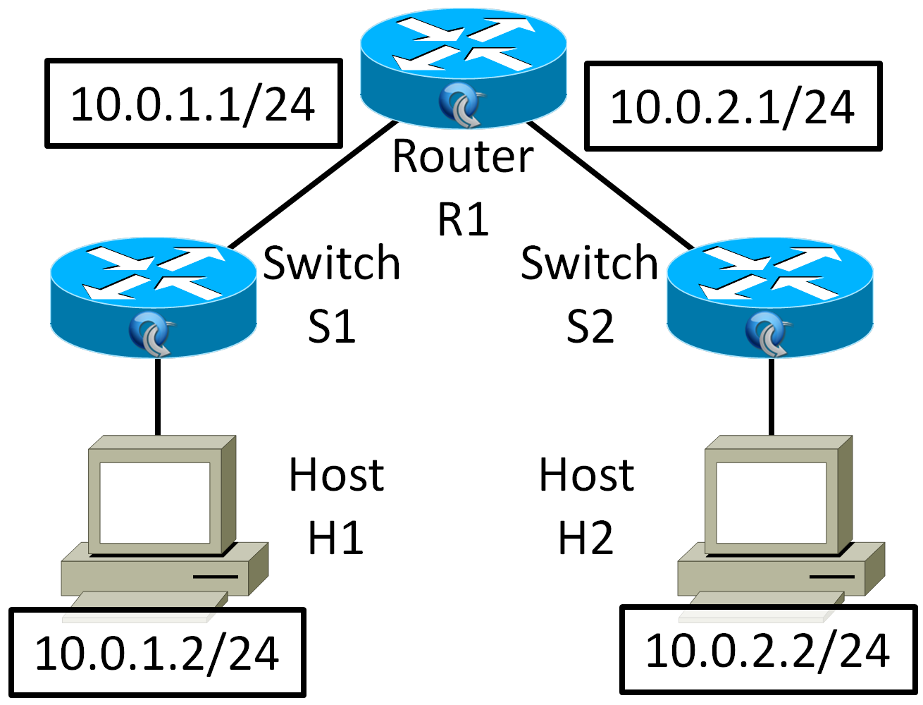
Routing statik
Spesifikasi
Topologi

Slide 3

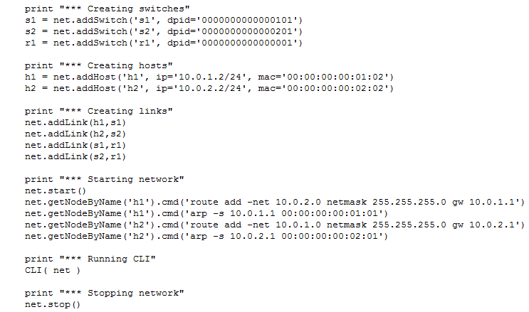

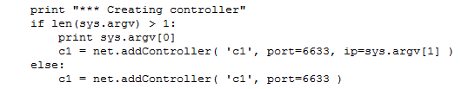
Routing statik : Implementasi
sudo /etc/init.d/openvswitch-controller stop
cd ~/sdna-router
sudo ./router-static.py
#ovs-ofctl
sudo ovs-ofctl add-flow r1 in_port=1,dl_dst=00:00:00:00:01:01,dl_type=0x800,nw_dst=10.0.2.2,actions=mod_dl_dst:00:00:00:00:02:02,output:2
sudo ovs-ofctl add-flow r1 in_port=2,dl_dst=00:00:00:00:02:01,dl_type=0x800,nw_dst=10.0.1.2,actions=mod_dl_dst:00:00:00:00:01:02,output:1
sudo ovs-ofctl add-flow s1 in_port=1,actions=output:2
sudo ovs-ofctl add-flow s1 in_port=2,actions=output:1
sudo ovs-ofctl add-flow s2 in_port=1,actions=output:2
sudo ovs-ofctl add-flow s2 in_port=2,actions=output:1

Slide 4
Routing statik : Pengujian
Ping
mininet> h1 ping h2
PING 10.0.2.2 (10.0.2.2) 56(84) bytes of data.
64 bytes from 10.0.2.2: icmp_req=1 ttl=64 time=1.24 ms
64 bytes from 10.0.2.2: icmp_req=2 ttl=64 time=0.229 ms
64 bytes from 10.0.2.2: icmp_req=3 ttl=64 time=0.189 ms
Traceroute
mininet> h1 traceroute h2
traceroute to 10.0.2.2 (10.0.2.2), 30 hops max, 60 byte packets
1 10.0.2.2 (10.0.2.2) 1.286 ms 0.529 ms 0.459 ms

Slide 5
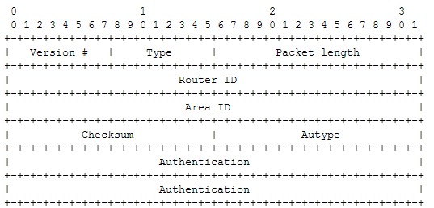
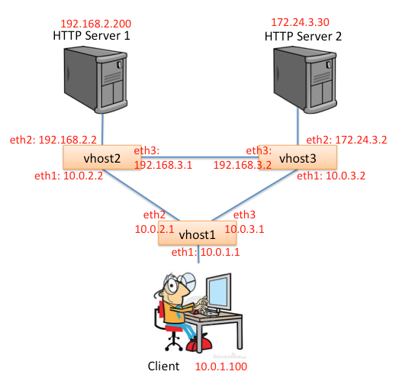
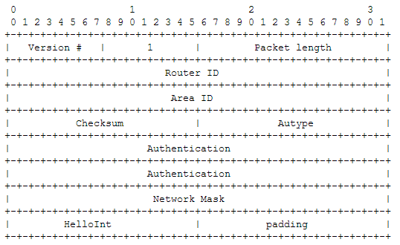
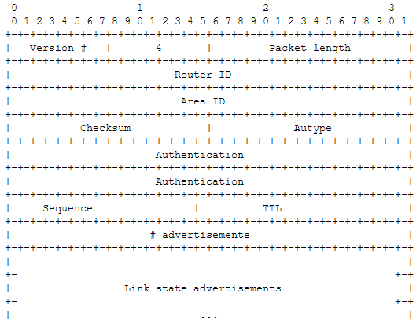
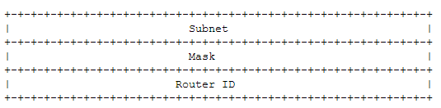
Routing OSPF-like (PWOSPF)
Spesifikasi
Topologi
Protocol overview
simplified link state routing protocol based on OSPFv2 (rfc 1247)
periodically broadcast HELLO packets to discover and maintain a list of neighbors
Whenever a change in a link status is detected (or a timeout occurs, each router floods its view of the network throughout the topology so that each router has a complete database of the network connectivity.
Djikstra's algorithm is used by each router independently to determine the next hop in the forwarding table to all advertised routes.
Data structure
Packet header
Hello packet format :packets are sent periodically on all interfaces in order to establish and maintain neighbor relationships
LSU packet format : flooding of link states and are used to build and maintain the network topology database at each router
Link state advertisement : reachable routes directly connected to the advertising router

Slide 6

Routing OSPF-like (PWOSPF) : Implementasi
Download skeleton code
Configure environment
> ./config.sh
Start mininet
> ./run_mininet.sh
Run controller (POX)
> ./run_pox.sh
Running multiple router
Vhost1
> ./run_sr.sh A.B.C.D vhost1
Vhost2
> ./run_sr.sh A.B.C.D vhost2
Vhost3
> ./run_sr.sh A.B.C.D vhost3
* A.B.C.D = IP publik/reachable controller

Slide 7
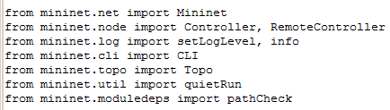
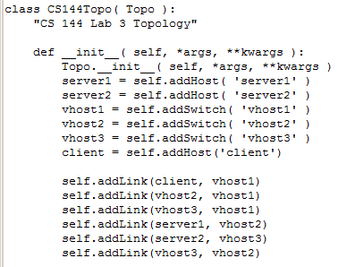
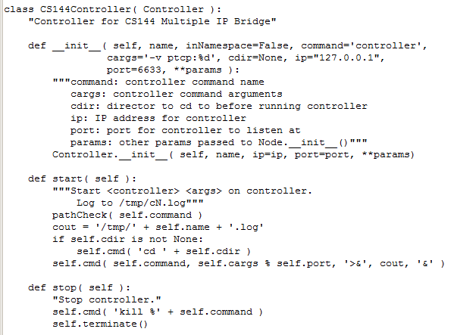

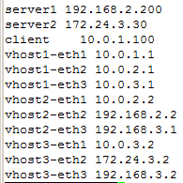
run_mininet.sh
sudo python pwospf_topo.py

Slide 8
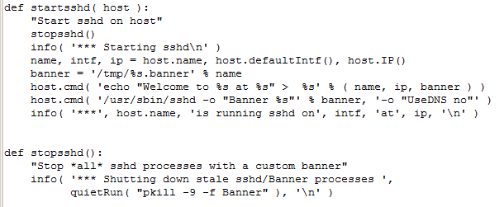
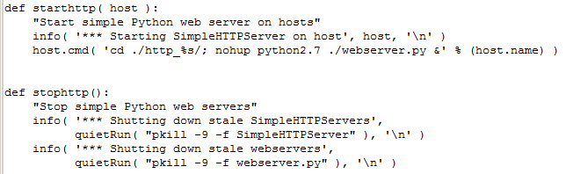
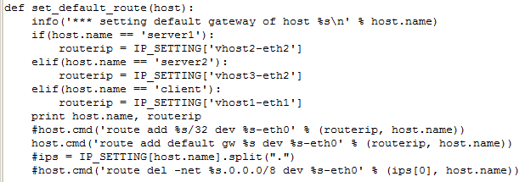
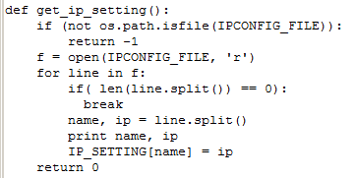
run_mininet.sh

Slide 9
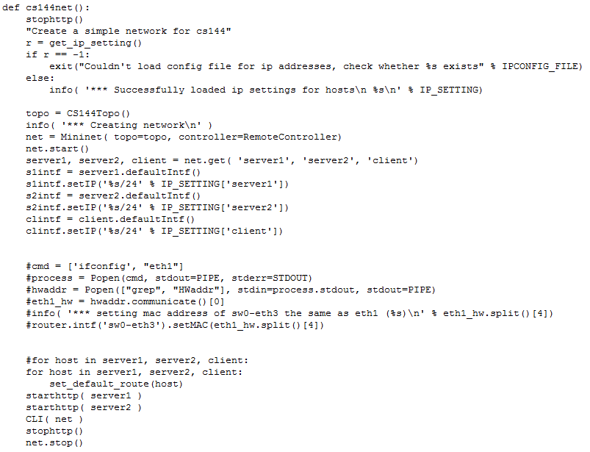
run_mininet.sh

Slide 10
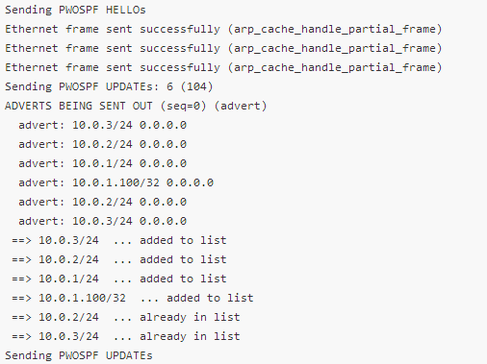

Routing OSPF-like (PWOSPF) : Implementasi

Slide 11
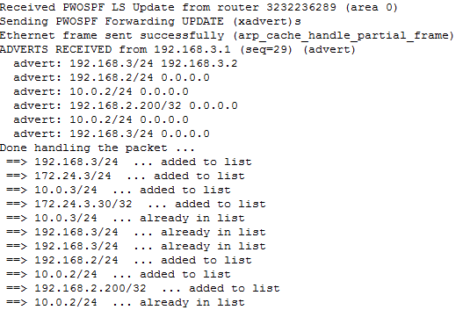
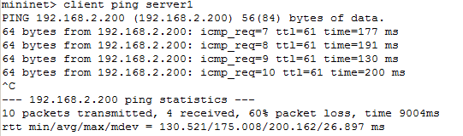
Routing OSPF-like (PWOSPF) : Pengujian
Traceroute (normal)
mininet> client traceroute server1
traceroute to 192.168.2.200 (192.168.2.200), 30 hops max, 60 byte packets
1 10.0.1.1 (10.0.1.1) 59.937 ms 60.293 ms 97.676 ms
2 10.0.2.2 (10.0.2.2) 217.243 ms 172.101 ms 271.566 ms
3 192.168.2.200 (192.168.2.200) 320.622 ms 320.633 ms 320.553 ms
ping (salah satu link putus)
Ping
mininet> client ping server1
PING 192.168.2.200 (192.168.2.200) 56(84) bytes of data.
64 bytes from 192.168.2.200: icmp_req=1 ttl=62 time=187 ms
64 bytes from 192.168.2.200: icmp_req=2 ttl=62 time=132 ms
64 bytes from 192.168.2.200: icmp_req=3 ttl=62 time=124 ms
64 bytes from 192.168.2.200: icmp_req=4 ttl=62 time=169 ms
mininet> client ping server2
PING 172.24.3.30 (172.24.3.30) 56(84) bytes of data.
64 bytes from 172.24.3.30: icmp_req=1 ttl=62 time=133 ms
64 bytes from 172.24.3.30: icmp_req=2 ttl=62 time=110 ms
mininet> client wget server1
--2013-10-22 21:03:13-- http://192.168.2.200/
Connecting to 192.168.2.200:80... connected.
HTTP request sent, awaiting response... 200 OK
Length: 161 [text/html]
Saving to: `index.html'
0K 100% 6.70M=0s
2013-10-22 21:03:14 (6.70 MB/s) - `index.html' saved [161/161]

Slide 12
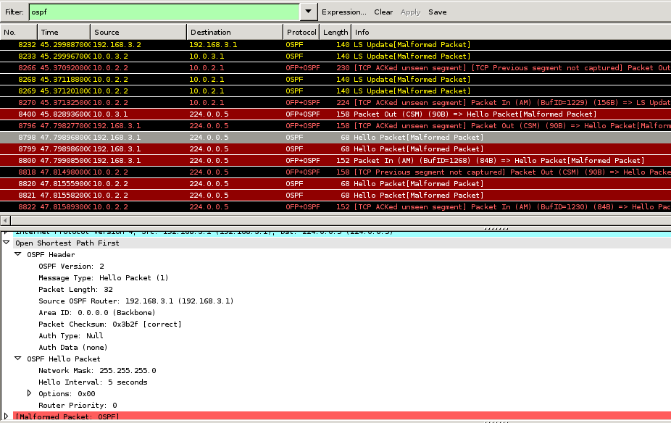
Routing OSPF-like (PWOSPF) : Pengujian
sudo wireshark &

